Slide 1

Demand Paging, Page Replacement Algorithms, Allocation of Frames

Slide 2
Background
Goal of Memory Management:
Instructions being executed must be in physical memory.
Review of Chapter # 9:
Fitting all program (as a results of Multitasking) into the physical memory is a challenge.
Continuous allocation of Memory -> Dynamic allocation problem (First-fit, Best-fit, Worst-fit) -> Fragmentation (External + Internal)
Solution to fragmentation -> #1: Compaction #2: Paging
Paging permits a process’s physical address space to be noncontiguous. It avoids external fragmentation and the associated need for compaction.

Slide 3
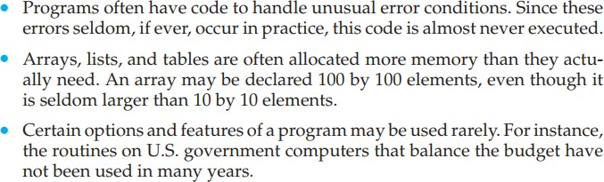
Do we need the entire program in memory?

Slide 4
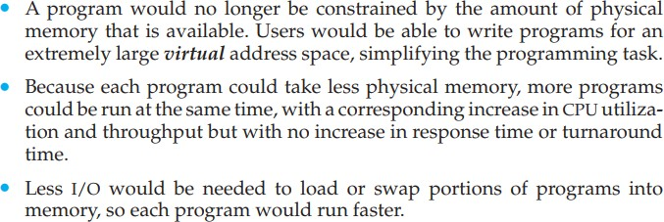
Benefits in program execution that is only partially in memory
Thus, running a program that is not entirely in memory would benefit both the system and its users.

Slide 5
Virtual Memory
Virtual memory is a computer memory management technique that allows a computer to use more memory than physically available by temporarily transferring data from RAM to hard disk storage.
Major advantage:
Programs can be larger than physical memory.
It provides an efficient mechanism for process creation.
May substantially decrease performance if it is used carelessly. Chapter # 10 examines how it is implemented, and explore its complexity and benefits.

Slide 6
Virtual Memory Vs Paging
Virtual memory and paging are closely related concepts, but they are not exactly the same.
Virtual memory refers to the technique of using disk storage to simulate additional RAM, while
Paging specifically refers to the process of transferring memory pages between RAM and disk storage. Paging is one aspect of virtual memory
Virtual memory covers a broader set of techniques that collectively enable the efficient use of memory resources in a computer system, such as
demand paging
page fault handling, and
memory allocation strategies

Slide 7
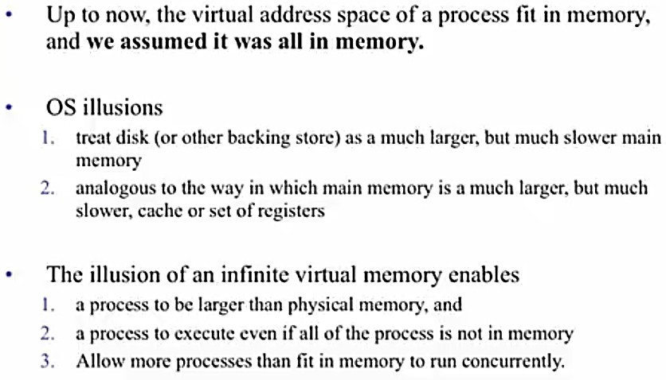
Demand Paging Paged Virtual Memory

Slide 8
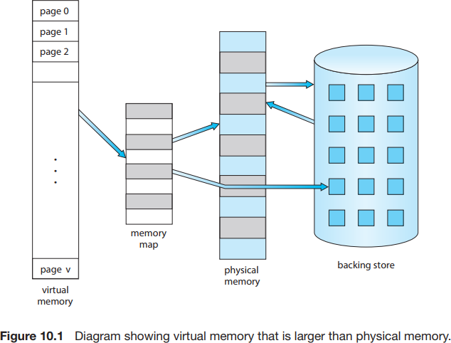
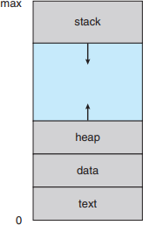
Logical or Virtual Address Space
The large blank space (or hole) between the heap and the stack is part of the virtual address space but will require actual physical pages only if the heap or stack grows. Virtual address spaces that include holes are known as sparse address spaces.

Slide 9
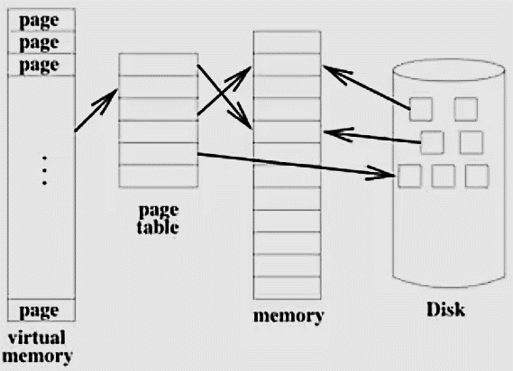
Page Fault
Page faults are expensive because they involve a time-consuming process of loading data from disk into physical memory. This requires disk I/O operations, which are slow compared to memory access times. Additionally, page faults can cause the operating system to stall the execution of a program until the required page is loaded, resulting in performance degradation.

Slide 10
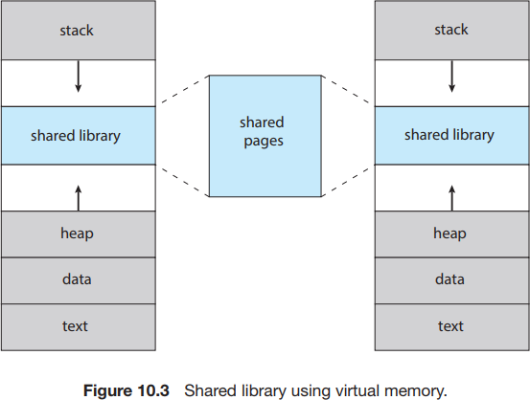
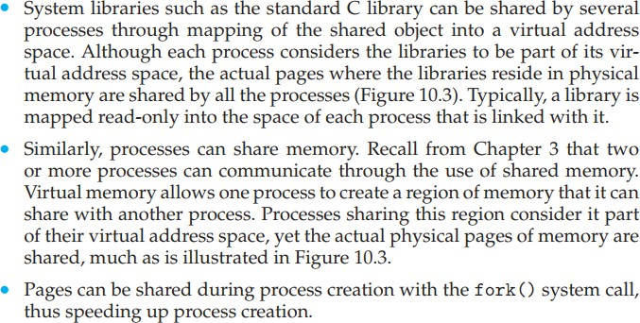
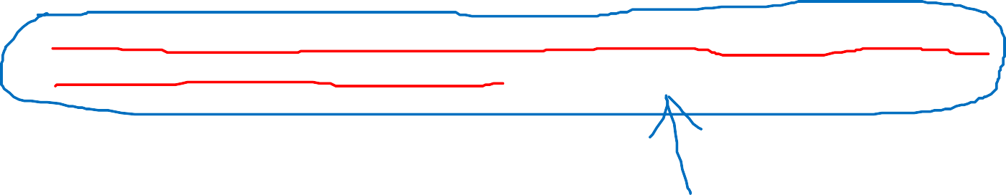
Virtual memory allows files and memory to be shared by two or more processes through page sharing (Section 9.3.4). This leads to the following benefits:

Slide 11
Scenario. Suppose a program starts with a list of available options from which the user is to select. Loading the entire program into memory results in loading the executable code for all options, regardless of whether or not an option is ultimately selected by the user.
An alternative strategy is to load pages only as they are needed. This technique is known as demand paging and is commonly used in virtual memory systems.
With demand-paged virtual memory, pages are loaded only when they are demanded during program execution. Pages that are never accessed are thus never loaded into physical memory.
A demand-paging system is similar to a paging system with swapping (Section 9.5.2) where processes reside in secondary memory (usually an HDD or NVM device).

Slide 12
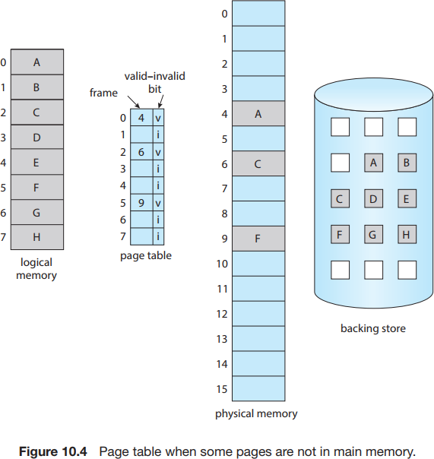

The valid– invalid bit scheme described in Section 9.3.3 can be used for pages not in memory.
When the bit is set to “valid,” the associated page is both legal and in memory.
If the bit is set to “invalid,” the page either is not valid (that is, not in the logical address space of the process) or is valid but is currently in secondary storage.
The page-table entry for a page that is brought into memory is set as usual, but the page-table entry for a page that is not currently in memory is simply marked invalid.
Notice that marking a page invalid will have no effect if the process never attempts to access that page.

Slide 13
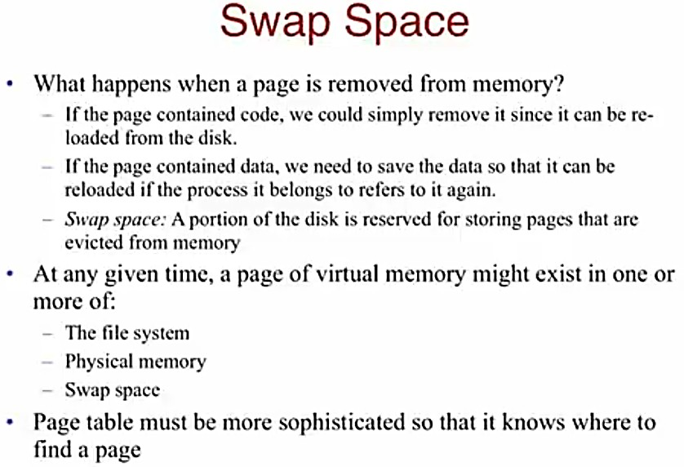
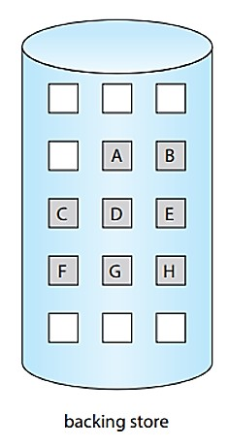

Slide 14
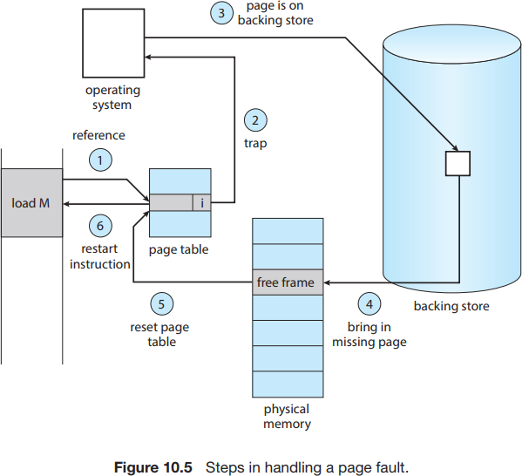
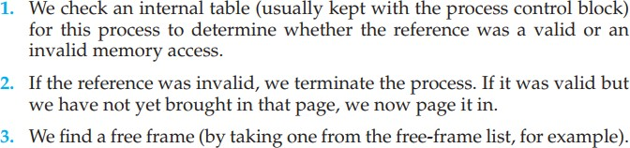
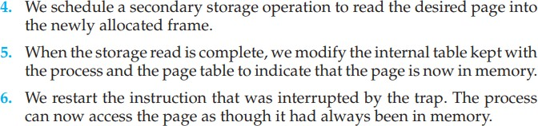
The procedure for handling this page fault is straightforward (Figure 10.5):
Page fault is generated if programs tries to access a page that is not memory (i.e. marks invalid in page table).
The paging hardware, in translating the address through the page table, will notice that the invalid bit is set, causing a trap to the operating system.

Slide 15
Pure demand paging: never bring a page into memory until it is required.
We can start executing a process with no pages in memory. When the operating system sets the instruction pointer to the first instruction of the process, which is on a non-memory-resident page, the process immediately faults for the page. After this page is brought into memory, the process continues to execute, faulting as necessary until every page that it needs is in memory. At that point, it can execute with no more faults.
Programs tend to have locality of reference, described in Section 10.6.1, which results in reasonable performance from demand paging.

Slide 16
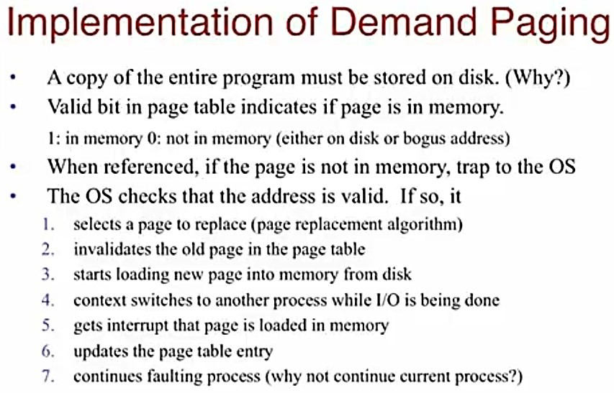

Slide 17
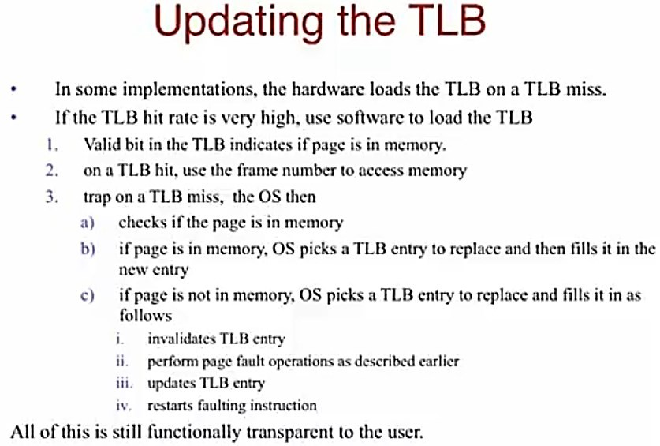

Slide 18
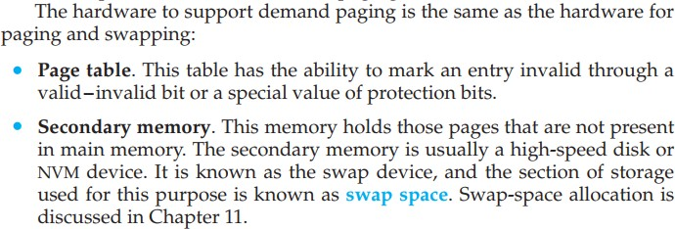

Slide 19








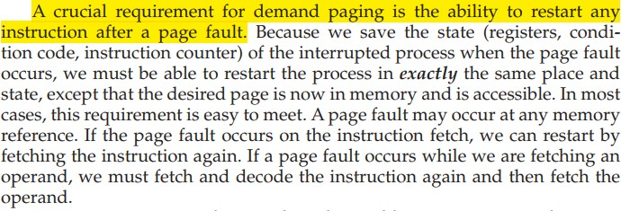
Restarting Instruction which resulted in a page fault

Slide 20
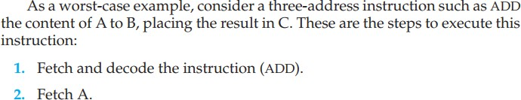
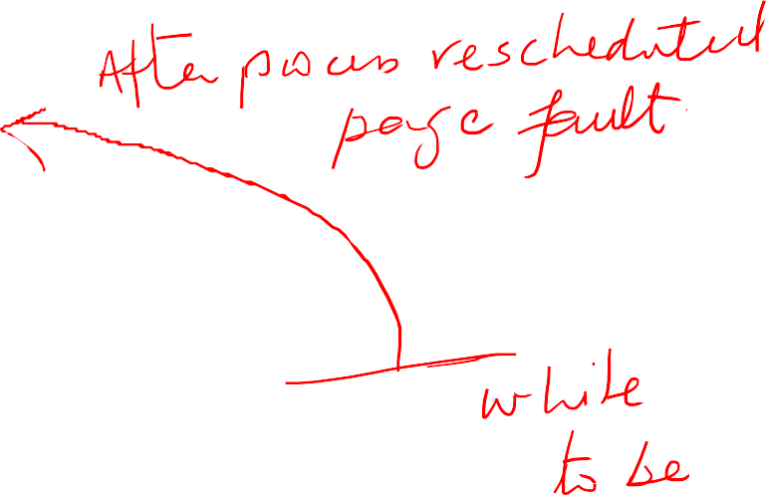

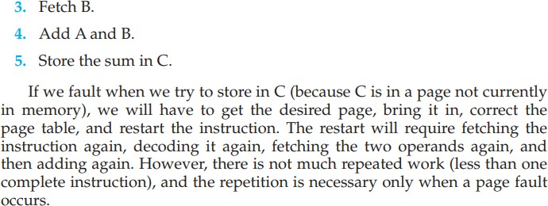

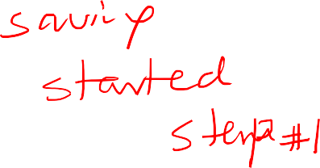


Restarting Instruction which resulted in a page fault

Slide 21
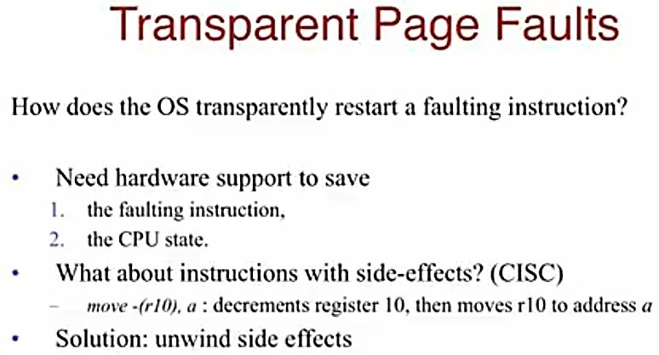
Restarting Instruction which resulted in a page fault

Slide 22
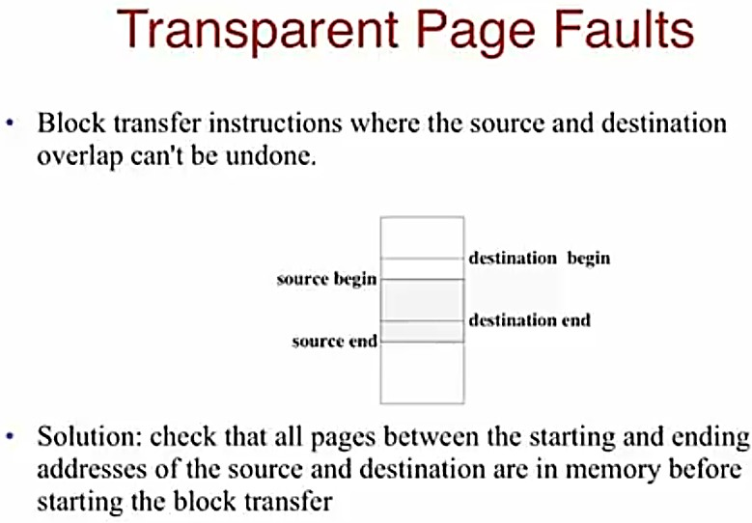
Restarting Instruction which resulted in a page fault

Slide 23
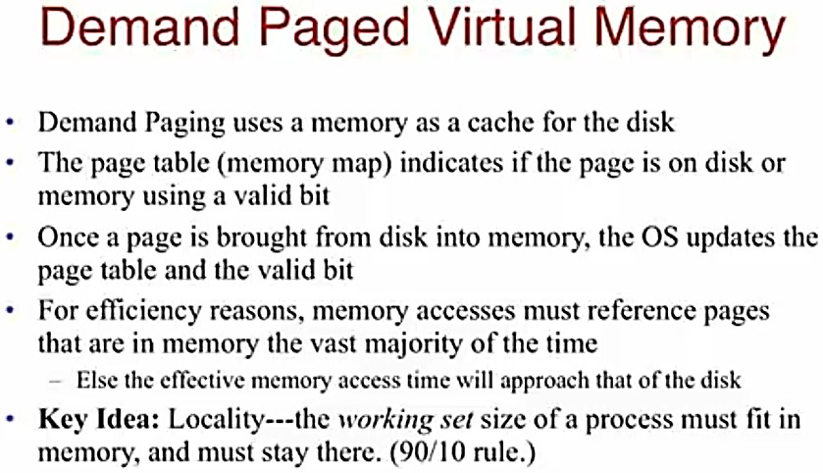

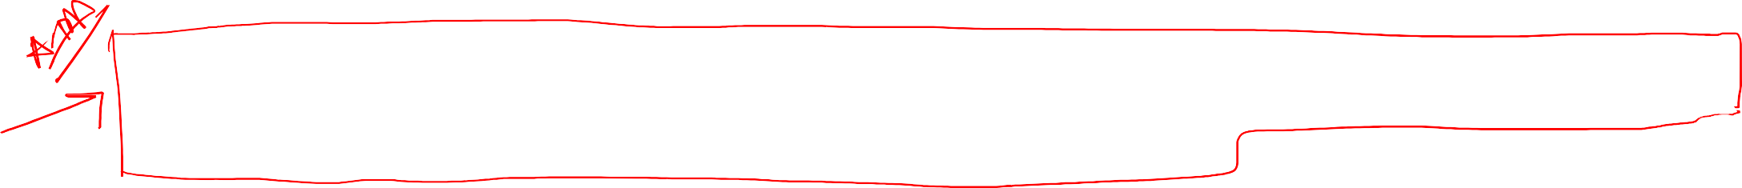

Slide 24
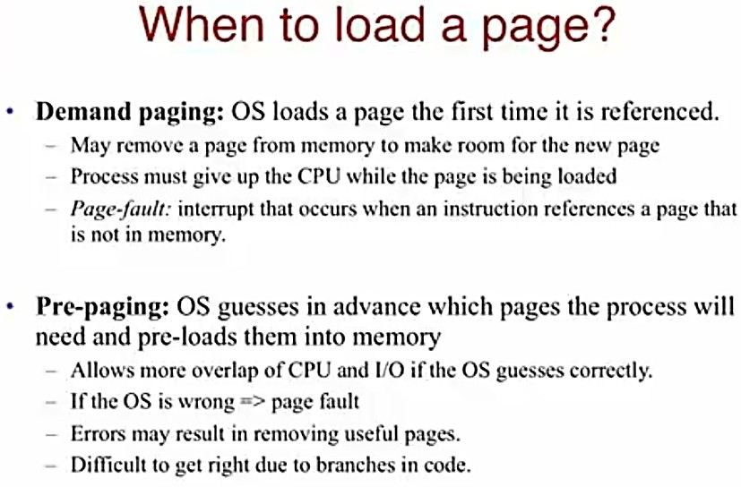

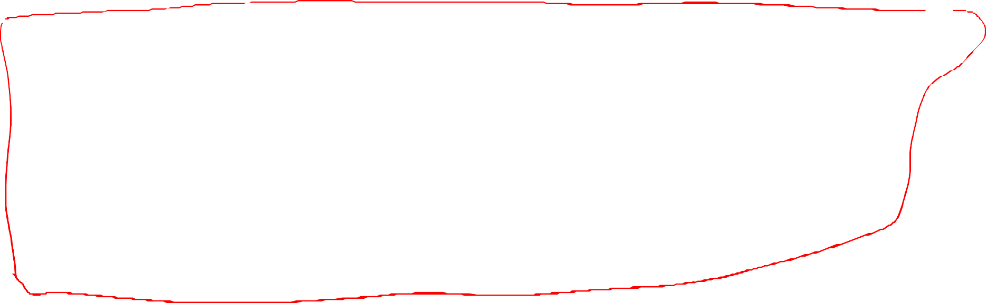

Slide 25
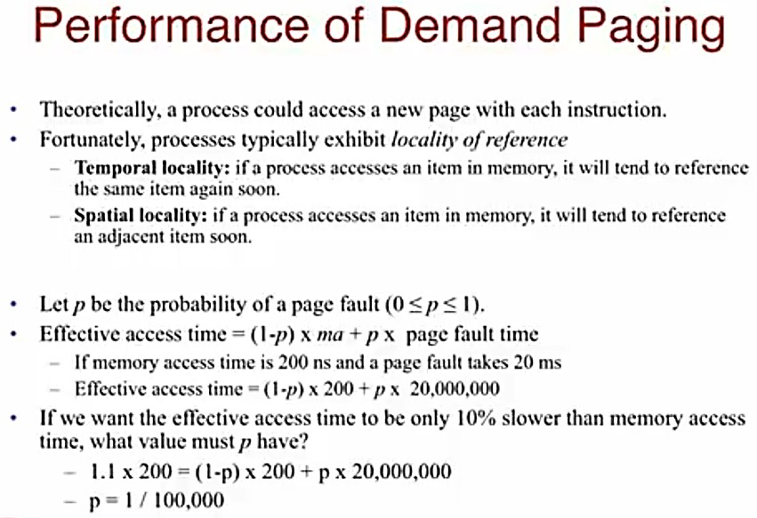

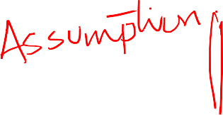
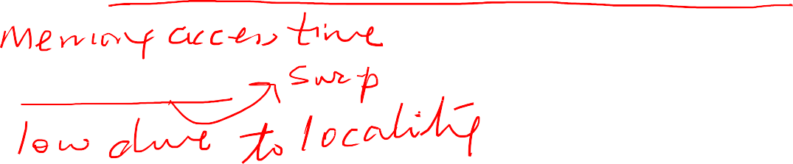
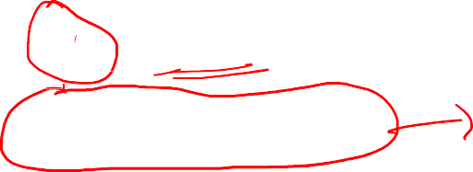





Slide 26
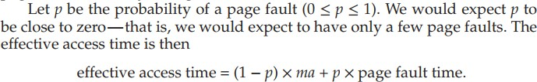

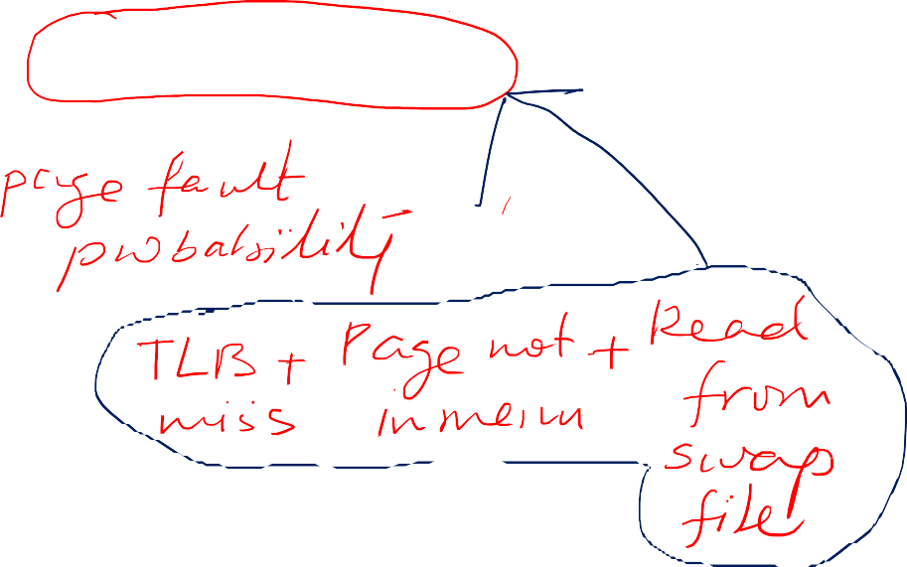










Slide 27
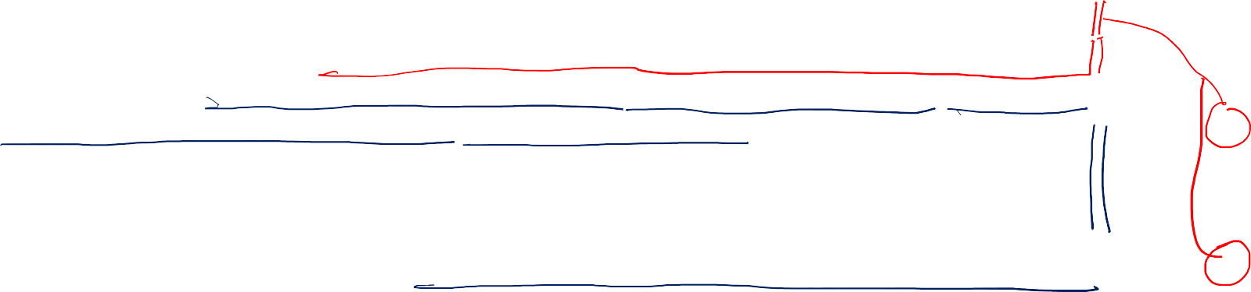
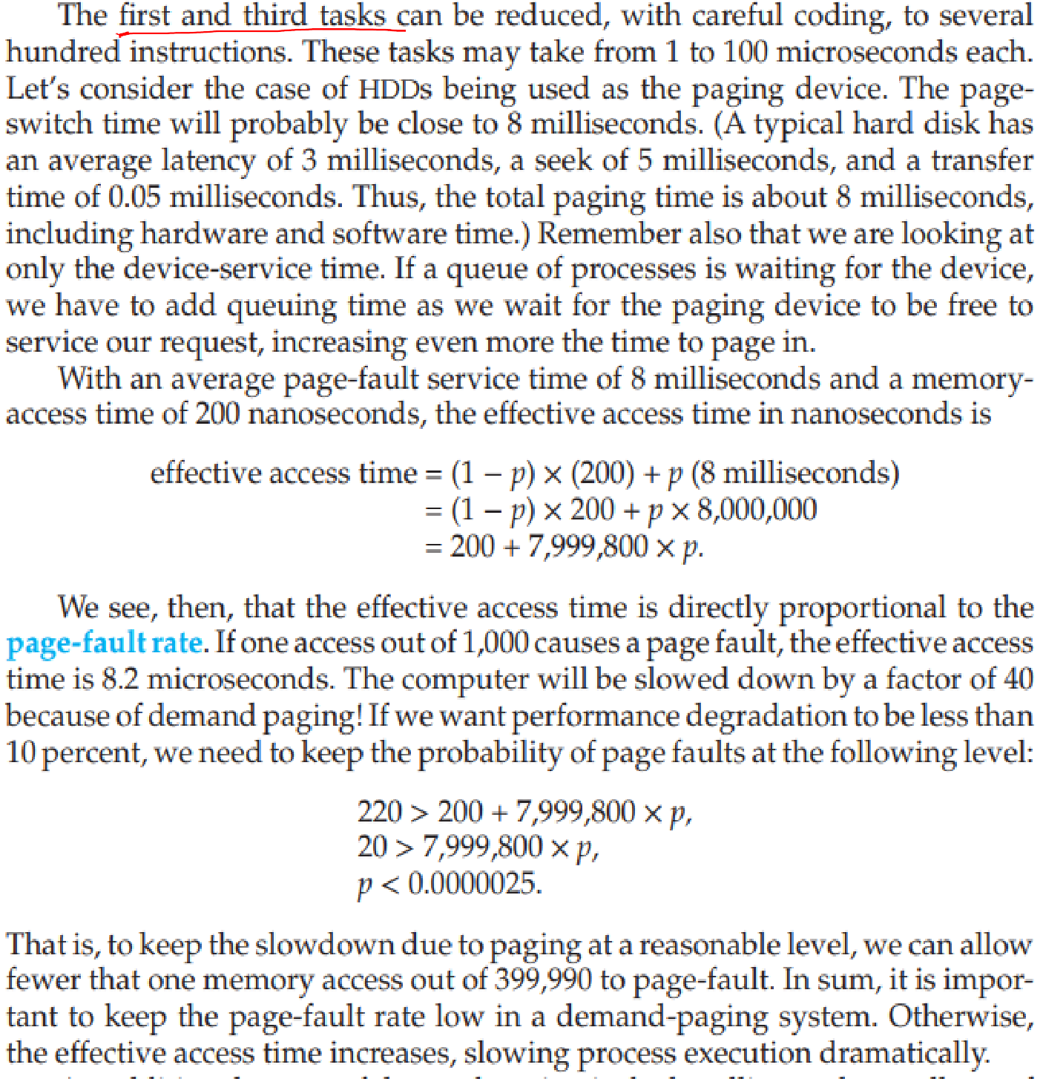
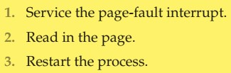
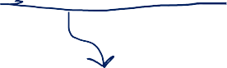






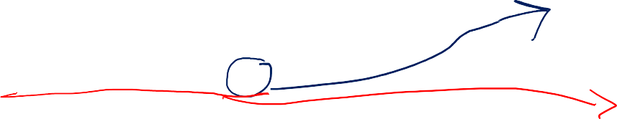
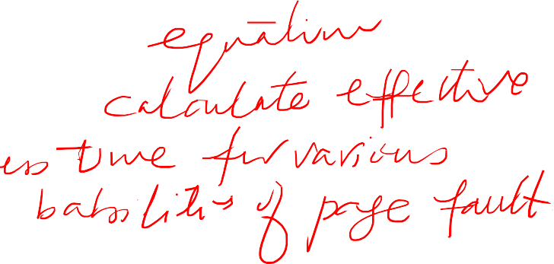



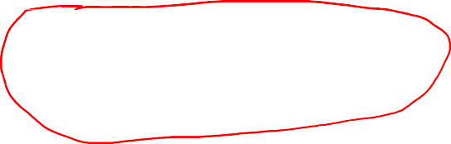


Slide 28




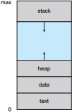










fork() system call creates a child process that is a duplicate of its parent. Traditionally, fork() worked by creating a copy of the parent’s address space for the child, duplicating the pages belonging to the parent. However, considering that many child processes invoke the exec() system call immediately after creation, the copying of the parent’s address space may be unnecessary.

Slide 29
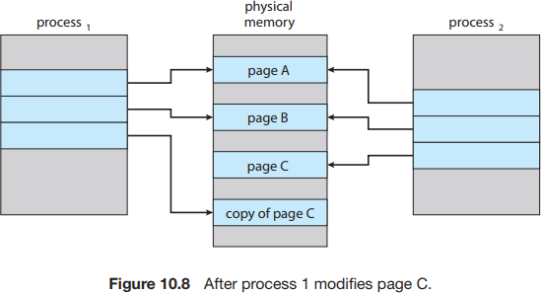
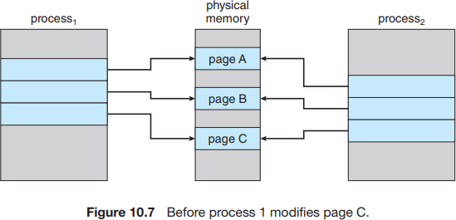
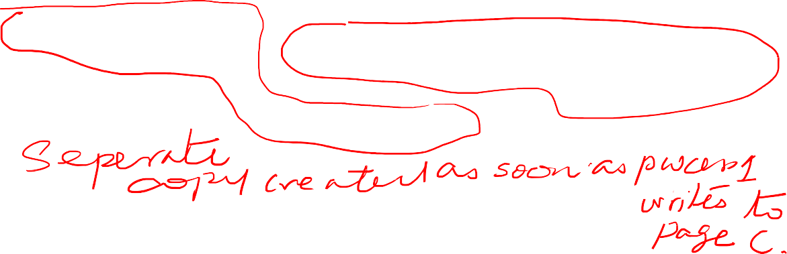
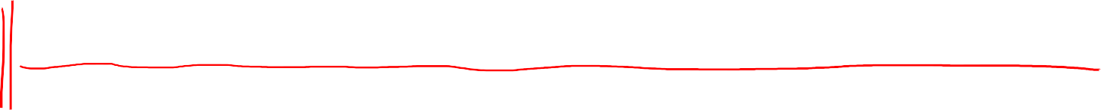
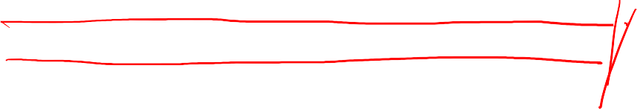
Instead, we can use a technique known as copy-on-write, which works by allowing the parent and child processes initially to share the same pages. These shared pages are marked as copy-on-write pages, meaning that if either process writes to a shared page, a copy of the shared page is created. Copy-on- write is illustrated in Figures 10.7 and 10.8, which show the contents of the physical memory before and after process 1 modifies page C.
Only pages that can be modified need be marked as copy-on-write. Pages that cannot be modified (pages containing executable code) can be shared by the parent and child. Copy-on-write is a common technique used by several operating systems, including Windows, Linux, and macOS.

Slide 30

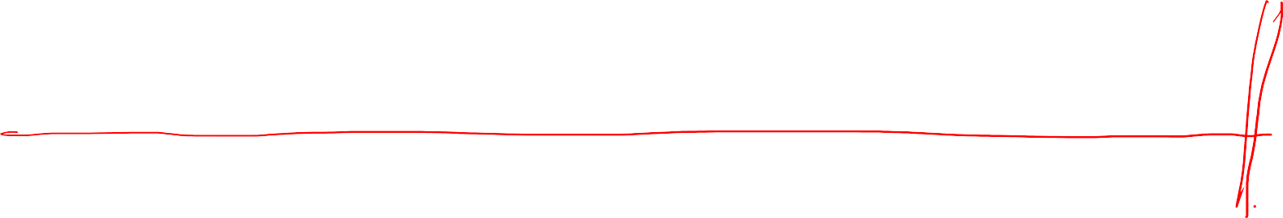

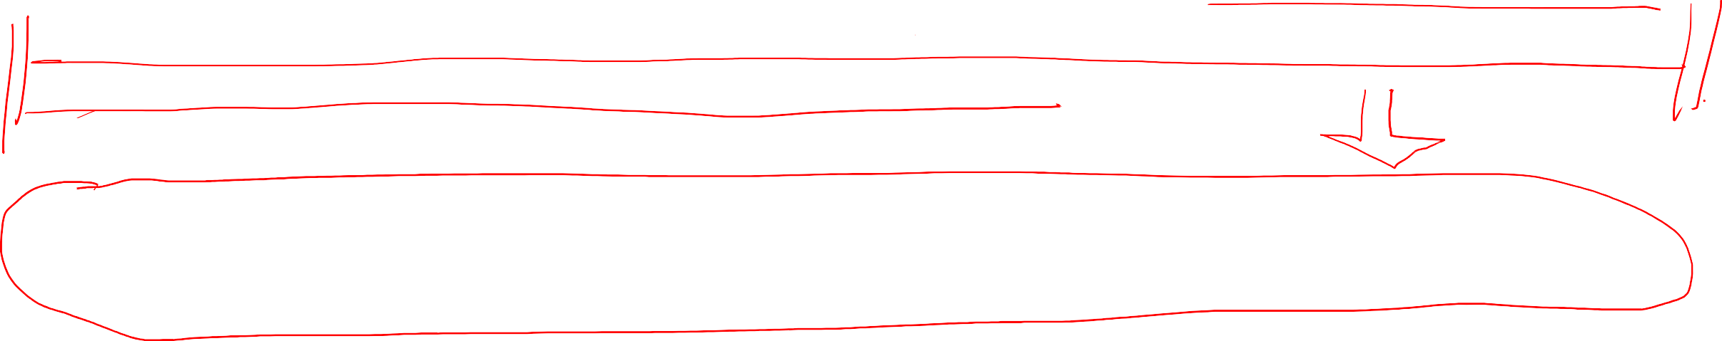
Frame Allocation vs Page Replacement
The frame allocation problem refers to the challenge of allocating limited physical memory frames among multiple processes or pages in a virtual memory system. It involves deciding how many physical memory frames to allocate to each process or page, and which frames should be allocated, to ensure efficient memory usage and minimize page faults.
The page replacement problem specifically refers to the challenge of selecting which page(s) should be evicted from physical memory when a page fault occurs and a new page needs to be brought in from disk.
The frame allocation problem deals with the initial allocation of physical memory frames to processes or pages, while the page replacement problem deals with the selection of pages to be replaced from physical memory when needed.

Slide 31











Page replacement is a mechanism used in demand paging, a virtual memory management technique, where the operating system selects a page from physical memory to be replaced with a new page from disk when there is no free memory available for a page requested by a process.
The selection of the page to be replaced is typically based on various algorithms, such as: Least Recently Used (LRU), FIFO, OPT, or Random algorithms.
The selected page is then evicted from physical memory, and the new page is loaded from disk into the vacated page frame.
It aims to optimize memory usage by efficiently managing limited physical memory resources and ensuring that the most frequently accessed pages are retained in memory, while less frequently used pages are replaced to disk.

Slide 32















If we increase our degree of multiprogramming, we are over-allocating memory.
If we run six processes, each of which is ten pages in size but actually uses only five pages, we have higher CPU utilization and throughput, with ten frames to spare.
However, it is possible that each of these processes, for a particular data set, may suddenly try to use all ten of its pages, resulting in a need for sixty frames when only forty are available. Same scenario can happen if Buffer allocated for I/O suddenly increase.
There are no free frames on the free-frame list; all memory is in use. This situation is illustrated in Figure 10.9, where the fact that there are no free frames is depicted by a question mark.

Slide 33




















If no frame is free, we find one that is not currently being used and free it.
We can free a frame by writing its contents to swap space and changing the page table (and all other tables) to indicate that the page is no longer in memory (Figure 10.10).
We can now use the freed frame to hold the
page for which the process faulted.
Standard swapping is no longer used by most operating systems due to the overhead of copying entire processes between memory and swap space.
Most operating systems now combine swapping pages with page replacement,

Slide 34











Slide 35















Page-fault service routine now has these additional steps with page replacement:

Slide 36






Modify bit (or dirty bit)
if no frames are free, two page transfers (one for the page-out and one for the page-in) are required. This situation effectively doubles the page-fault service time and increases the effective access time accordingly.
We can reduce this overhead by using a modify bit (or dirty bit) attached to each page or frame in the hardware.
If the modify bit for a page is set by the hardware whenever any byte in the page is written into,
indicating that the page has been modified and need to be updated to storage.
If the modify bit is not set, however, the page has not been modified (or is read-only like executable code pages) since it was read into memory. Therefore, the page can be discarded safely.
This technique also applies to read-only pages (for example, pages of binary code). Such pages cannot be modified; thus, they may be discarded when desired. This scheme can significantly reduce the time required to service a page fault, since it reduces I/O time by one-half if the page has not been modified.

Slide 37








Evaluation of Page Replacement Algorithms

Slide 38

Evaluation of Page Replacement Algorithms

Slide 39








How number of available frames relates to page faults?
Reference string 1, 4, 1, 6, 1, 6, 1, 6, 1, 6, 1
For three or more frames, we would have only three faults— one fault for the first reference to each page.
If only one frame available, we would have a replacement with every reference, resulting in eleven faults.
In general, we expect a curve such as that in
Figure 10.11.
As the number of frames increases, the number of page faults drops to some minimal level. Of course, adding physical memory increases the number of frames.

Slide 40
























Introduction to Page Replacement Algorithms

Slide 41


Slide 42







Slide 43




















Slide 44




Slide 45


Slide 46





Slide 47


Slide 48



Slide 49


Belady’s anomaly: for some page-replacement algorithms, the page-fault rate may increase as the number of allocated frames increases. We would expect that giving more memory to a process would improve its performance. In some early research, investigators noticed that this assumption was not always true.

Slide 50


Slide 51
Implementation of LRU
2nd Chance
Enhanced 2nd Chance Algorithms

Slide 52
















Slide 53










Slide 54











Slide 55
















Slide 57


Slide 58


Slide 59










Each page is in one of these four classes. When page replacement is called for, we use the same scheme as in the clock algorithm; but instead of examining whether the page to which we are pointing has the reference bit set to 1, we examine the class to which that page belongs. We replace the first page encountered in the lowest nonempty class. Notice that we may have to scan the circular queue several times before we find a page to be replaced. The major difference between this algorithm and the simpler clock algorithm is that here we give preference to those pages that have been modified in order to reduce the number of I/Os required.

Slide 60


Slide 61
Class work: Solve and Submit the end-of- chapter #10 questions on the next slides

Slide 62




Slide 63



Slide 64


